Slide 1
Pls 2000 power & politics dr. shannon
CIVIL SOCIETY

Slide 2
Civil Society
I. CIVIL SOCIETY
II. HOMEWORK CASES
TERMS TO KNOW
Civil society Civil Disobedience Social Movements
Elitism Pluralism Salt March
Corporatism Uncle Tom’s Cabin Boston Tea Party
The Jungle Silent Spring Unsafe at Any Speed
Sit-Ins Suffragists Interest Groups

Slide 3
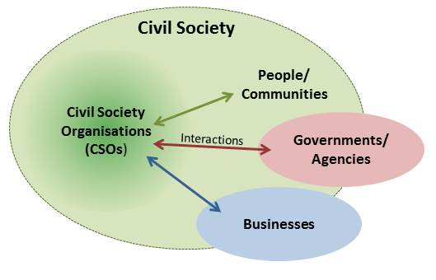
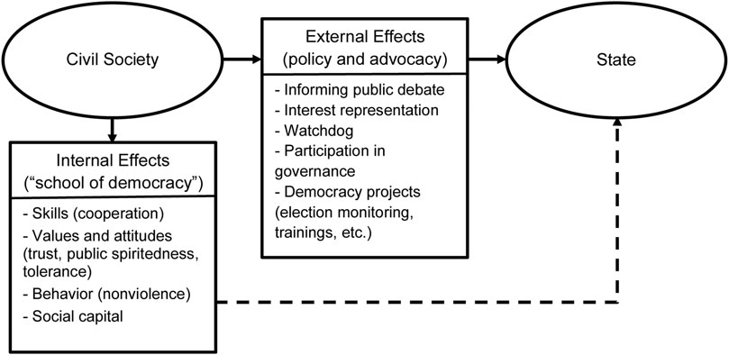
i. Civil society
The range of private institutions existing between the individual and the state (p.7)
The framework within which those without political authority live their lives (p.265)

Slide 4
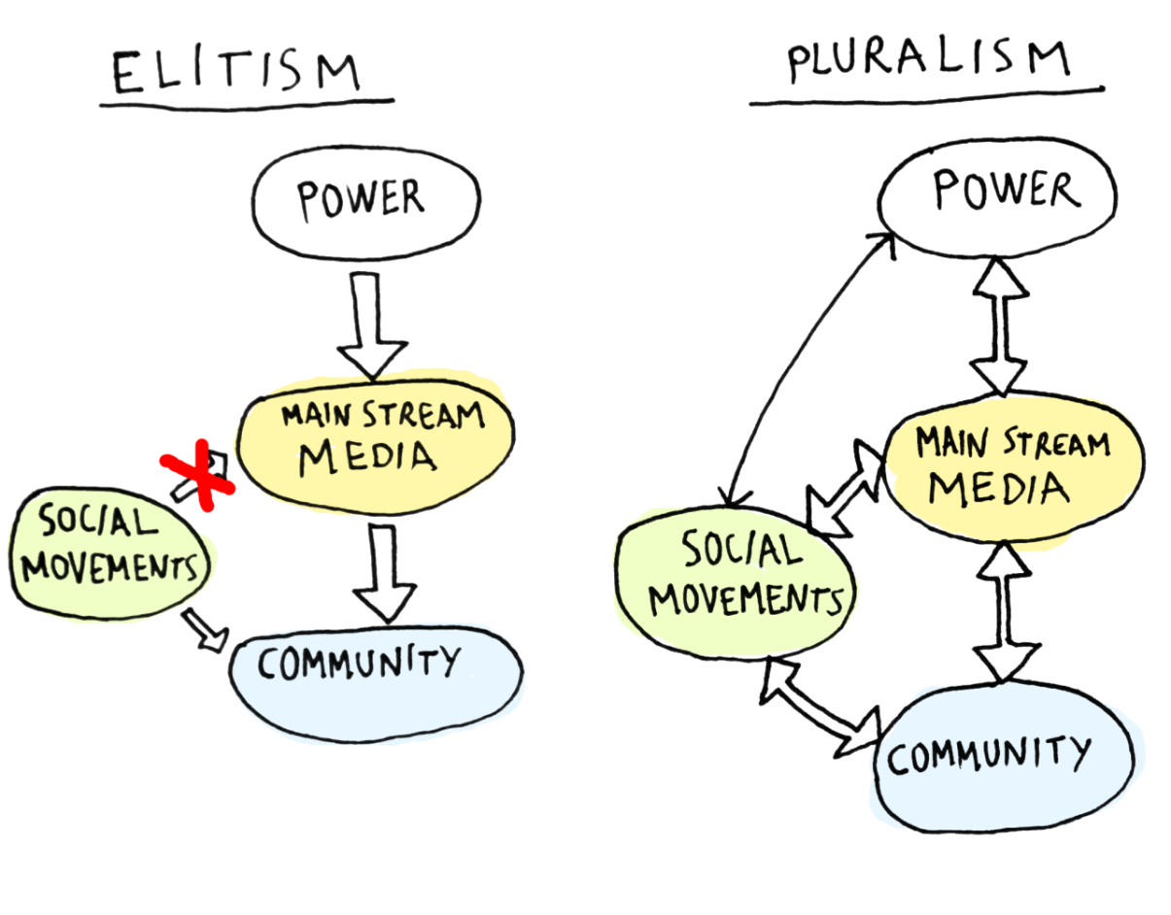
Theories of POLITICAL INFLUENCE
Pluralism: Emphasis on competition between groups of citizens
Policy is the result of interest group competition & bargaining among group elites
Elitism: Policy from elites with no accountability to, or access by, the public
Complementary interests reinforce each other
http://journalistsresource.org/studies/politics/finance-lobbying/the-influence-of-elites-interest-groups-and-average-voters-on-american-politics
http://www.motherjones.com/kevin-drum/2011/02/secret-weapon-rich-money

Slide 5
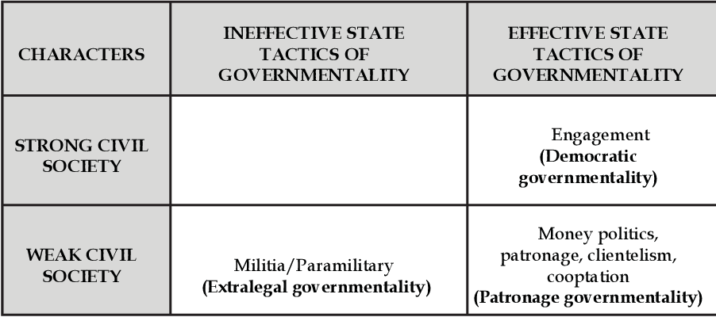
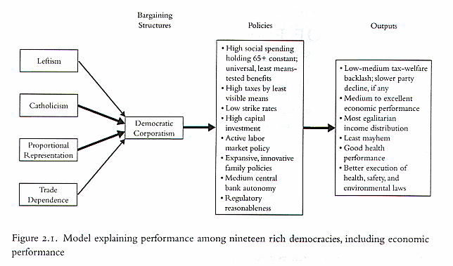
State-society relations
Cooptation & Patron-Client Relations
Corporatism: Formalized arrangements between the state and peak associations for regular consultation over policy
Societal (Democratic): Bottom-up
UK Confederation of British Industry and Trades Union Congress
State Corporatism: Top-down selection of approved, favored groups
Japan’s MITI

Slide 6
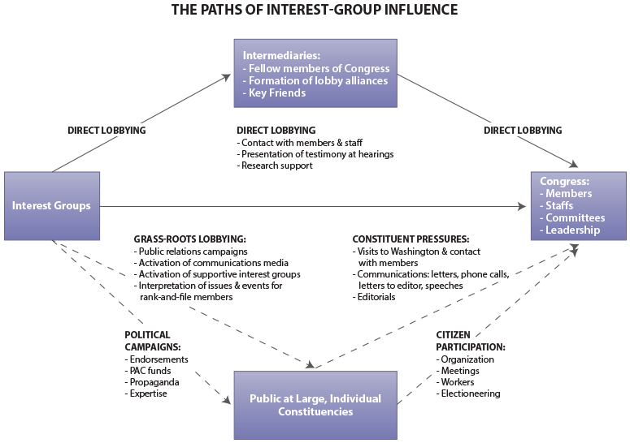
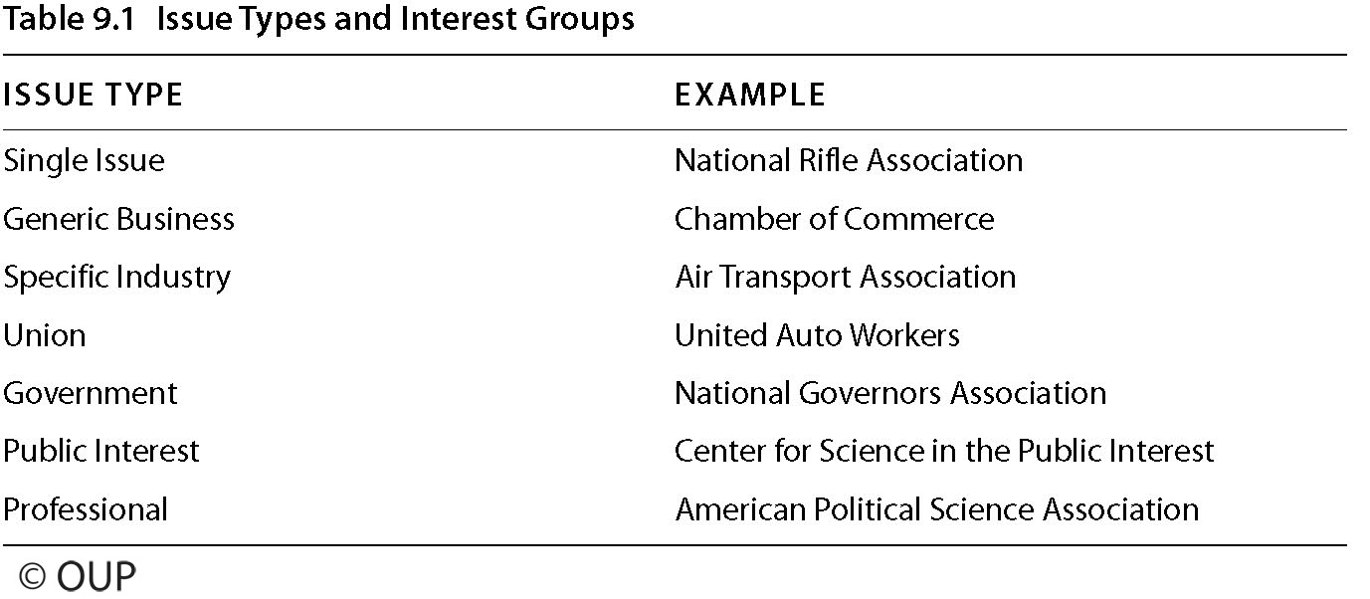
Interest groups
Def: Formal associations formed to promote a sectional interest in the political system through lobbying government and winning over public opinion

Slide 7
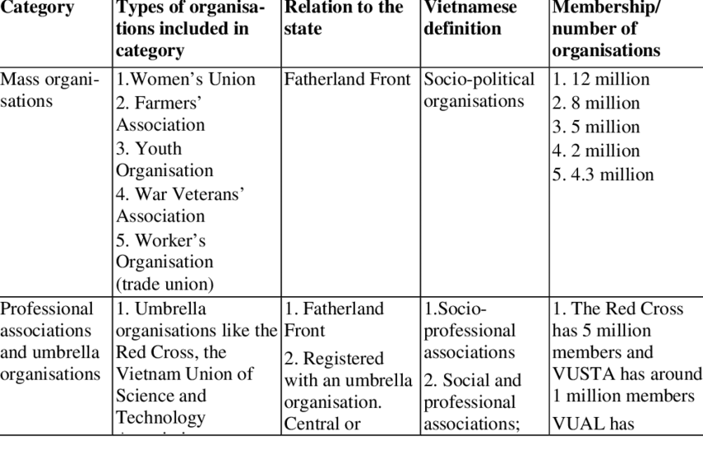
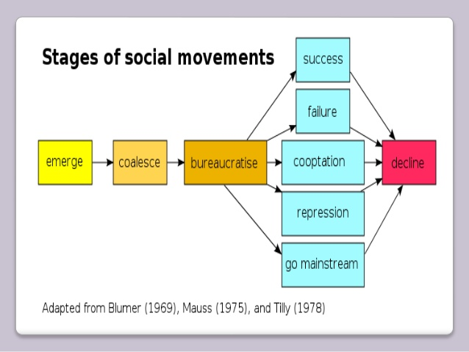
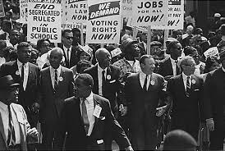
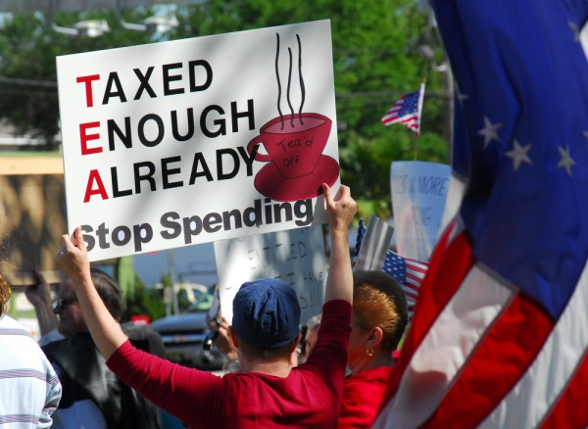
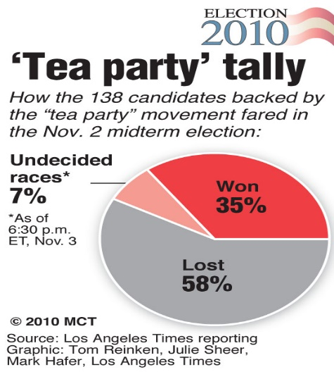
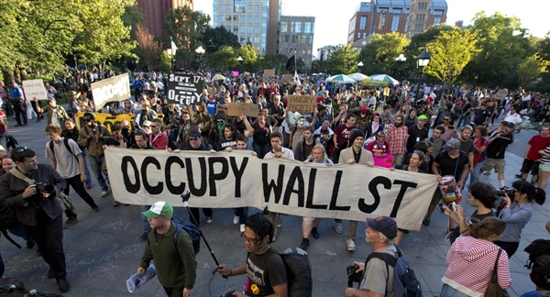
Social movements and civil society organizations
https://www.researchgate.net/figure/Main-categories-of-civil-society-organisations_tbl1_237284897

Slide 8
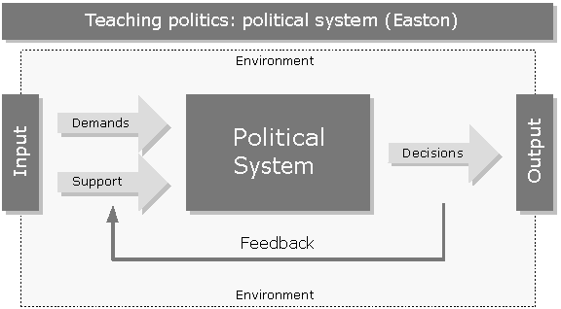
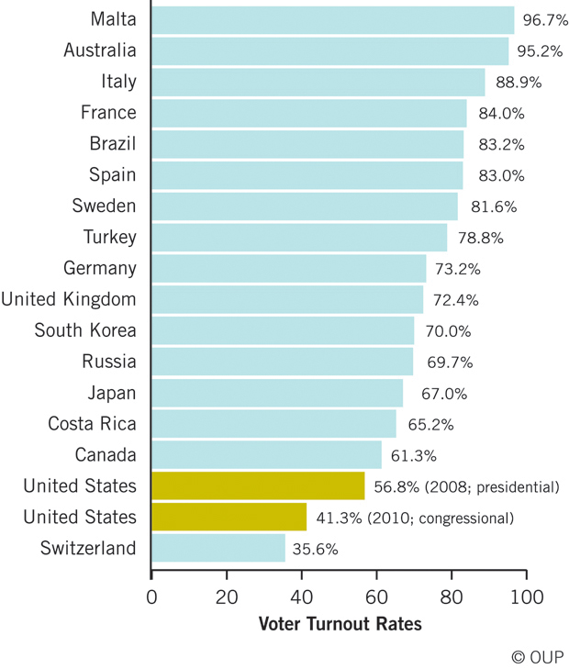
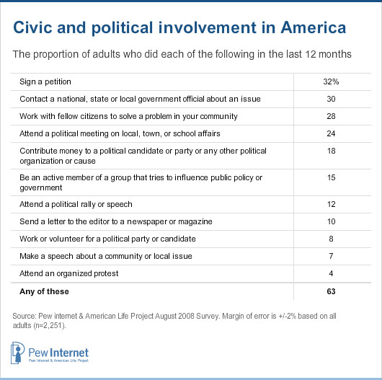
Political participation
Activities citizens undertake to influence government behavior
Voting
Write Representatives or address public forum
Sign petitions
Boycott
Protest
Legal/illegal
Violent/non-violent

Slide 9
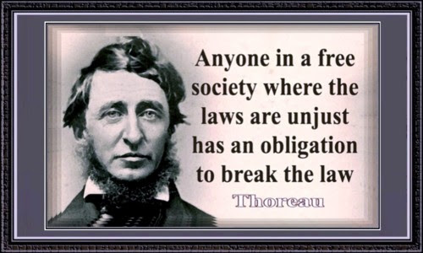
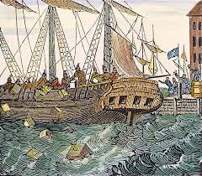
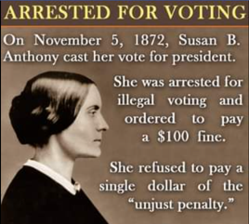
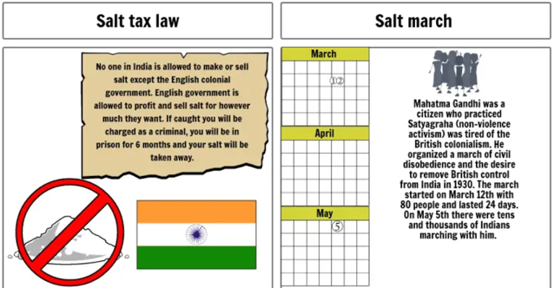
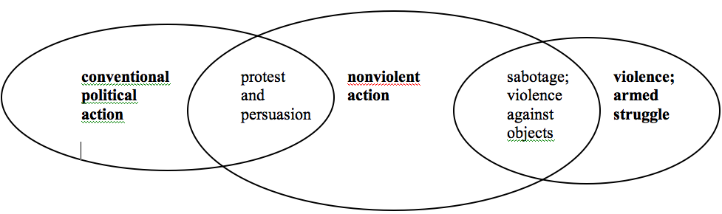
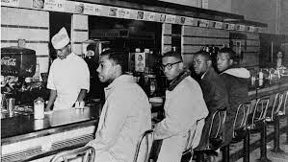
Civil disobedience
a public, non-violent and conscientious breach of law undertaken with the aim of bringing about a change in laws or government policies
Cases:
Boston Tea Party
Mahatma Gandhi’s Salt March: 80,000 arrested for making salt from the sea
Suffragists illegal ballots
Sit-Ins at Whites-only lunch counter
https://www.storyboardthat.com/storyboards/631d07b5/salt-march
https://plato.stanford.edu/entries/civil-disobedience/

Slide 10
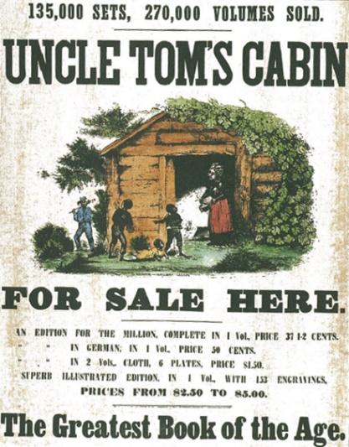
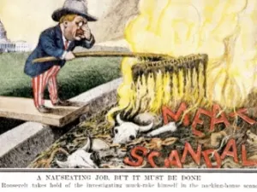
II. Homework case studies
Harriet Beecher Stowe, Uncle Tom’s Cabin (1852)
Abolitionist Movement
Fugitive Slave Act required that all escaped slaves captured in free territory were to be returned to their masters, and that all residents in these free territories must cooperate with the law (or face $1000 & 6 mo. In prison)
Upton Sinclair, The Jungle (1906)
Sinclair hoped to bring attention to labor conditions, immigrant laborers and “wage slavery” but readers “fixated on descriptions of rotten meat, filled with toxic chemicals, dirt, sawdust and rat droppings.”
June 1906 Pure Food and Drug Act & Meat Inspection Act prohibited mislabeled & adulterated food products
https://ap.gilderlehrman.org/essays/uncle-tom%C3%A2%E2%82%AC%E2%84%A2s-cabin-and-matter-influence
https://www.history.com/news/7-things-you-may-not-know-about-the-jungle
https://www.albert.io/blog/abolitionist-movement-ap-us-history-crash-course-review/

Slide 11
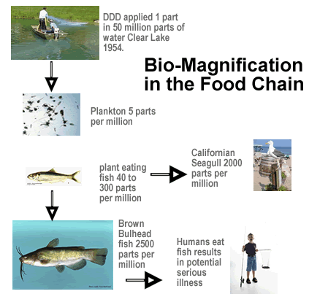
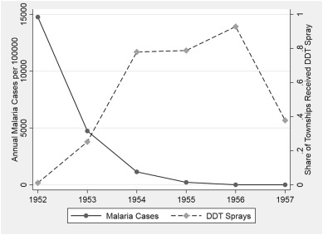
II. Homework case studies
Rachel Carson, Silent Spring (1962)
exposed the hazards of the pesticide DDT, which entered the food chain and accumulated in the fatty tissues of animals & humans, and caused cancer and genetic damage.
President Kennedy’s Science Advisory Committee vindicates: DDT banned in 1972
New public awareness that nature was vulnerable to human intervention: The need to regulate industry to protect the environment became widely accepted, and environmentalism was born.
DDT still could be produced and exported.
https://www.cdc.gov/biomonitoring/pdf/ddt_factsheet.pdf
https://corporatesocialresponsibility4.weebly.com/chapter-case.html
https://www.nrdc.org/stories/story-silent-spring

Slide 12
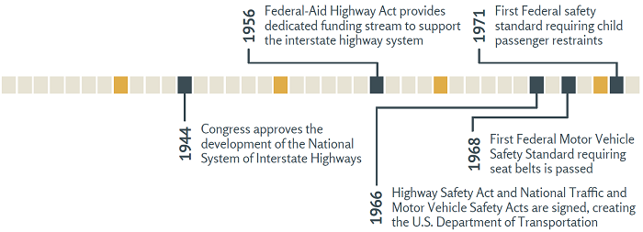
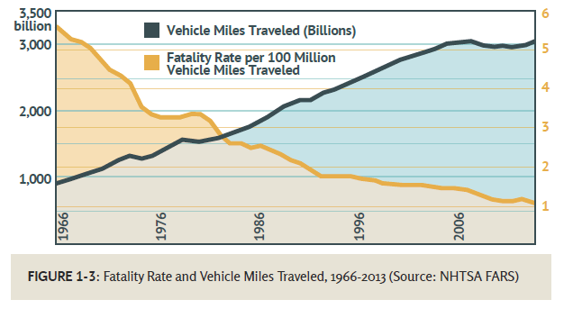
II. Homework case studies
Ralph Nader, Unsafe at Any Speed (1965)
Prompted the passage of the National Traffic and Motor Vehicle Safety Act of 1966, seat-belt laws and a number of other road-safety initiatives.
Nader argued the Chevy Corvair epitomized the triumph of “stylistic pornography over engineering integrity.” (Its swing axle made the back end unstable, he said, causing it to “tuck under during turns and skid or roll over much more frequently than other cars did.)
A 1972 government study vindicated the Corvair, finding that it was just as safe as any other car but the damage was done. The Corvair became an icon of dangerous, even deadly design, and stopped production in 1969.
https://rspcb.safety.fhwa.dot.gov/RSF/Unit1.aspx
https://www.history.com/this-day-in-history/unsafe-at-any-speed-hits-bookstores
https://corporatesocialresponsibility4.weebly.com/chapter-case.html
https://www.nrdc.org/stories/story-silent-spring

